Slide 1


November 6th, 2023
1:00pm – 4:00pm
Oregon Conservation and Recreation Fund
Advisory Committee Meeting
Virtual Meeting

Slide 2
Agenda Item 1:
Review and Approve Meeting Minutes
(October 2nd 2023)

Slide 3
Draft Motion Templates re: Minutes
I move to approve the October 2nd, 2023 meeting minutes with the continued authority to correct spelling, grammar, and punctuation.
I move to approve the October 2nd, 2023 meeting minutes with the addition/correction/ deletion of ____ on page ___, line ____, and continued authority to correct spelling, grammar, and punctuation.

Slide 4
Agenda Item 2:
OCRF Program Updates

Slide 5
OCRF Program Updates
Foundant: being built out for the OCRF program, will be up & running by next RFP
New Advisory Committee review platform (create account)
Northern Basin & Range Seat: 2 applications submitted
December 15: OAR Revisions will be presented to ODFW Commission for approval.
Notes:
Conducted outreach, and OCRF representation at the Oregon outdoor recreation programs, trail alliances, Diversifying the pool of applicants that apply to OCRF. Hopefully this helps address the

Slide 6
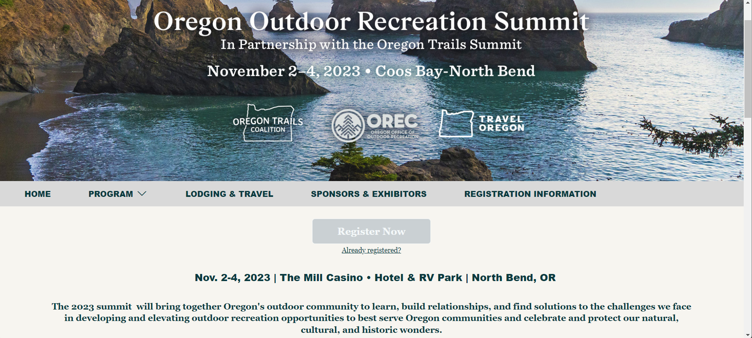
Nov 2-3, 2023; Oregon Outdoor Recreation Summit
Outreach: Two OCRF presentations (Program Overview , WTP) + Open Office Hours Tabling event.

Slide 7
OCRF Meeting Schedule 2023/2024
Dec 4 : Wrap-up; Final Strategic Planning Meeting
Jan 8: Spring RFP considerations / determinations, OAH Council
Feb 5: Review Final Draft of Strategic Plan

Slide 8
OCRF RFP Timeline - Spring 2024
Request for Proposals (RFP) – Open January 30th, 2024
Official RFP Guidance made public (remains open for 60 days)
Informational Session – February 20th, 2024
(Recording to be posted on website)
Week of Reminder of grant closure – March 18th, 2024
Request for Proposals (RFP) – Closes March 30th, 2024
Application must be received by 11:59pm
Technical Review Period – April 1st to May 1st, 2024
OCRF Advisory Committee Review Period – May 2nd to May 30th, 2024
OCRF Advisory Committee Recommendations – June 10th, 2024
ODFW Commission Voting – mid June, 2024
Release of funds following contracting process – August 2024

Slide 9
Agenda Item 3:
OCRF Project Presentation: “Pollinator Habitats”
Dasha Foerster with Green Lents

Slide 10
Agenda Item 4:
Public Comment

Slide 11
Agenda Item 5:
Stakeholder Outreach Update

Slide 12
OCRF Sentiment – Grant applicants, ODFW, ODFW Commission, Rep Helm
Success and Gratitude: Overwhelmingly positive comments about the work of the committee. High level of appreciation for the unique opportunities provided by the fund, the work being done and the dedication of committee members. OCRF has established a strong reputation.
Project Diversity: Big and small, statewide coverage, and the variety of project types is great.
Outreach Broadening access to groups not traditionally involved seems to be a success so far.

Slide 13
Suggested Priorities and Actions
Improve storytelling to:
Demonstrate results
Help OCRF stand out
Connect people and communities to the concepts OCRF supports
Seek and utilize partnerships that can:
Diversify project types
Tell the OCRF story
Augment funding options
Continue to build relationships with groups not traditionally involved in this space – broadening awareness of conservation need s/b a priority
Be flexible and prioritize – funds are and may continue to be limited
Focus investment on habitat protection and restoration, priority species and mitigating the impacts of climate change
Maintain momentum and commitment to the cause – have a plan for onboarding new committee members.
Continue passive fundraising efforts

Slide 14
Summary – Words of Advice
Continue to be good stewards – this goes a long way
Be an effective supplement to other funding sources
Stay true to original purpose, but flex to the funds that come your way
Clearly communicate project criteria for each grant cycle as funds become more focused
OCRF can’t solve everything – but continue to dream big, set high expectations for what can be done!

Slide 15
Specific Opportunities
Focused Invest: Prioritize the protection of key habitats, habitat connectivity, and conservation efforts as outlined in the Oregon Conservation Strategy. Coordinate with ODFW to better understand the current priorities from their perspective. Don’t forget about the Nearshore Strategy. Habitat Protection just as important as restoration. Think water and land and larger landscapes vs. one piece at a time.
How can the OCRF create role for itself in planning for climate change. Consider how OCRF project impact climate outcomes
Conscious Outreach: Avoid operating behind a partition and actively engage with non-traditional groups and organizations to ensure a broad range of organizations can benefit from the OCRF. Partnering with organizations like "View of the Future" can help extend OCRF's reach to new audiences.
Project Outcomes: Sharing success stories and the outcomes of funded projects can help garner support and attract potential donors. Let the projects speak for themselves. Request support from grant awardees.
Funding: Sustainable funding is not the committee’s problem to solve, but don’t shy away from marketing OCRF results.
Broaden Impact: Consider adopting a model like the Oregon Community Foundation, where unfunded projects are made available for donors to choose from. Direct applicants to other funding sources that may be better for them when applicable.

Slide 16
Application Process & Decisions
Clarity : Generally praised for transparency during meetings. Being able to follow the entire decision-making process during meetings is preferred.
Comparison with Other Processes: OCRF's process is seen as more complex than other processes, such as Metro, but recognize these are state dollars. Collaborative efforts with organizations like the Oregon Boating Foundation may expand OCRF’s ability to fund more projects.
Equity and Access: Provide more grace and consideration to individuals and organizations that do not have a long track record and/or significant experience with the grant making process.
Support Large-Scale Projects: Recognize that large-scale projects often require funding beyond the current 50K grant limit. Consider a larger cap for certain projects. At the same time, value seen in the wide distribution of funds.
Challenges for Recreation: The application process and, at times, the funding criteria is more favorable towards science-based projects and doesn't cater well to recreation-focused initiatives.

Slide 17
Agenda Item 6 :
Break
(Please be back in 5min)

Slide 18
Agenda Item 7:
Strategic Plan – Focus Areas, Goals and Actions

Slide 19
Key Questions to be Answered
What has the OCRF accomplished thus far?
What should be our strategic priorities?
Do we have specific goals related to those priorities?
What actions will we take in the next 4 years?
Are we effective in the communication of our accomplishments?
Does OCRF need effectiveness monitoring and for what purpose?
How do we create an adaptable grant program that can be scaled up or down depending on available funding?
What are our storytelling and communication goals?
Is there a need for continued private fundraising?
What type of fundraising activities should be completed and by whom?
How do we engage with partners who are interested in the OCRF?

Slide 20
Current State Analysis
Storytelling/Public Perception
(Application Process/ Resources
Funding
Partnerships
Focus 4 Investment
From SWOT/PEST, categories that emerged:

Slide 21
Agenda Item 8:
Meeting Wrap-up

